Slide 1
The Academic Health Sciences Center
East Tennessee State University
November 28, 2012
Notes:
Thank you for allowing us the opportunity to speak to you today. Many of us see prescription drug abuse in our practice sites, but how much do we actually do to prevent and stop it? We are here today to encourage you to make a difference in the lives of your patients and

Slide 2
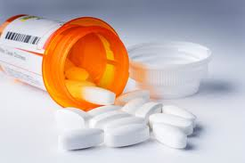
What is Prescription Drug Abuse?
The intentional use of a medication in a way other than is prescribed or for the experience or feeling it causes.¹
Notes:
We’re going to start off with some basic information and definitions to make sure we are all on the same page. So, what exactly is prescription drug abuse? Many laypeople believe that because a medication is prescribed by a physician or approved by the FDA, it is completely safe. However, many prescription medications have abuse potential that can lead to addiction and even overdose and death.
http://www.drugabuse.gov/publications/drugfacts/prescription-over-counter-medications

Slide 3
Is Prescription Drug Abuse Really an Issue?
6.1 Million (2.4%) people aged 12 and up used prescription medications non-medically in the last 12 months
Where do they get drugs?²
54.2% = friend or relative
18% = one provider
1.9% = multiple providers
Notes:
Prescription Drug Abuse is a serious issue within the United States. Over 6 million people in the United States abused prescription medications at least once in the last year. Most of these people get them from a friend or relative. This shows we are not properly educating our patients on the dangers of sharing their medications.
From my experiences, many healthcare providers believe if you are misusing medications, you are a drug-seeker. However, according to the National Survey on Drug Use and Health, of those who get the abused medications from doctors, a very small amount are going to multiple providers. Just because someone is abusing/is addicted to prescription drugs does not mean he is doctor-shopping.

Slide 4
Prescription Drug Abuse in Teenagers
2.8% of youths aged 12 to 17 currently use prescription medications non-medically²
96.5% of addicts began substance abuse before the age of 21
Notes:
As you can see from these two percentages – 2.8% compared to 2.4% - teenagers abuse prescription drugs at a disproportionately higher rate. While this difference may seem minor, teenagers who misuse prescription drugs are much more likely to become addicted and stay addicted into adulthood.

Slide 5
Addiction
A primary, chronic disease of brain reward, motivation, memory, and related circuitry
Affects 40 million Americans³
Notes:
Addiction effects more people in the US than most disease states. Heart Disease effects 27 million, Diabetes effects 26 million, and Cancer effects 19 million. Addiction can alter the structure and function of the brain and dramatically affect judgment and behavior. Addiction is not a personal or moral failure – it is a disease that can be prevented and treated.

Slide 6
Tolerance
Occurs when a drug is used repeatedly over time
Biological response in which receptors are less responsive to the original dose, and therefore require a higher dose to achieve the same effect⁴
Often, tolerance to certain effects develops more rapidly than others⁵
Notes:
The chronic use of controlled substances, as well as many other medications, can lead to tolerance. This is a biological response in which receptors respond less to the original dose, but require a higher dose to achieve the same effect. It is important to note that tolerance to different effects develops at different rates. For example, with opiates, tolerance to the euphoric effect develops faster than tolerance to physiological effects such as constipation. Another example of this concept can be illustrated by sedative effects. Tolerance develops quickly to sedation, while tolerance to respiration depression and lowering blood pressures develops slowly. This becomes important when the patient increases the dose or frequency at which they abuse the medication to continue to experience the desired effects– their body has not yet adapted to the other physiologic effects and this can result in a fatal overdose as a result of respiratory failure.
http://www.drugabuse.gov/publications/teaching-packets/neurobiology-drug-addiction/section-iii-action-heroin-morphine/6-definition-toleranceI’
Goodman & Gilman’s The Pharmacological Basis of Therapeutics. 12th Edition. Brunton, Laurence; Bruce Chabner; Bjorn Knollman. Pages 652-3.

Slide 7
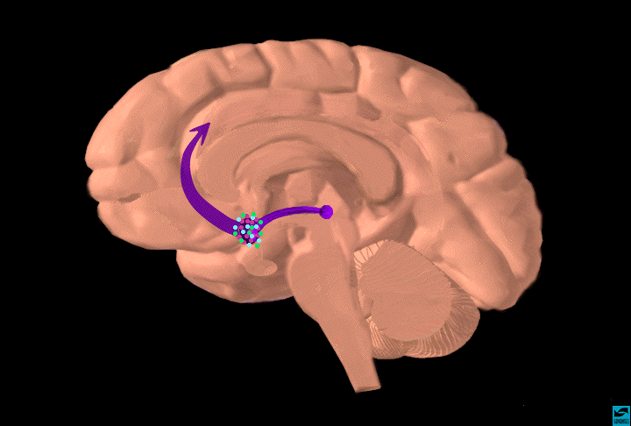
Dopamine Pathways
Neurobiology of Addiction
frontal
cortex
VTA
nucleus
accumbens
Functions
reward (motivation)
pleasure, euphoria
compulsion
perseveration
decision making
Notes:
The 3 major components of the neural circuitry include the ventral tegmental area (VTA), the nucleus accumbens, and the prefrontal cortex. A stimulus is interpreted as rewarding if it increases firing of impulses from the ventral tegmental area to the nucleus accumbens. All addictive drugs induce strong feelings of euphoria or award by actually altering normal dopamine pathways and increasing dopamine transmission. This occurs in the Ventral Tegmental Area and Nucleus Accumbens. The vast majority of drug addictions involve alcohol, nicotine, opiates, and CNS stimulants. All of these drugs ultimately produce pleasure upon administration through their actions on the reward pathway, but the mechanisms preceding the final common event, increasing dopamine concentration in the Nac, differ signficantly from each other.

Slide 8
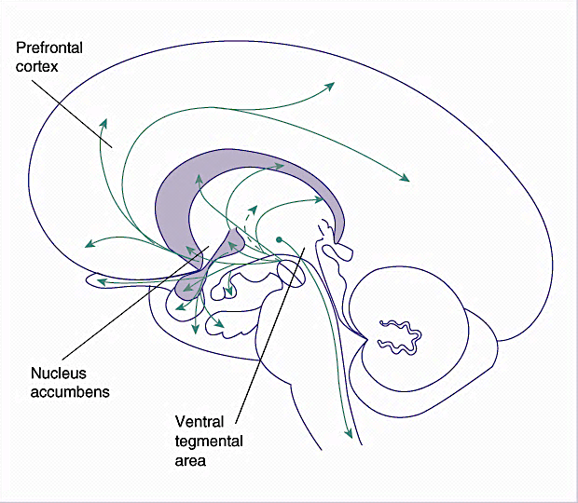
Addiction
Ventral Tegmental Area
opioids
benzodiazepines
amphetamines
Nucleus Accumbens^{6,7}
amphetamines
Notes:
While each drug class increases dopamine in the mesolimbic pathway, they do so by different mechanisms. Opioids and benzodiazepines work in the ventral tegmental area to “disinhibit” dopamine neurons. Amphetamines work in both the ventral tegmental area and the nucleus accumbens to increase dopamine release and inhibit the reuptake of dopamine. These changes in brain pathways eventually lead to a new homeostasis within the body. When the treatment is abruptly discontinued, this homeostasis is disrupted and functioning is impaired. This disruption causes withdrawal to occur, which is the only physical symptom of addiction and dependence.

Slide 9
What Can You Do to Help Prevent Addiction?
Use the Universal Precautions of Prescribing
Notes:
Now that we’ve reviewed some of the basics of prescription drug abuse and addiction, we’d like to discuss some of the things you can do to prevent these issues. Originally adapted from an infectious disease model, the universal precautions of prescribing aims to prevent and monitor for the abuse of prescription drugs. Just like with infectious disease, these precautions are implemented by every healthcare professional. It is the job of every member of the healthcare team to ensure these steps are taken to improve patient outcomes and begin to stop this epidemic. You may have heard of many of these precautions, and may see this as a return to the basics. However, as we have seen from the statistics we just went over, we are obviously not implementing these basic steps as well as we should. As we go through these, think about what you can do in your own practice to make sure these precautions are taken for your patients.
http://www.painedu.org/populations-archive.asp?ArticleNumber=19&UserID=0

Slide 10
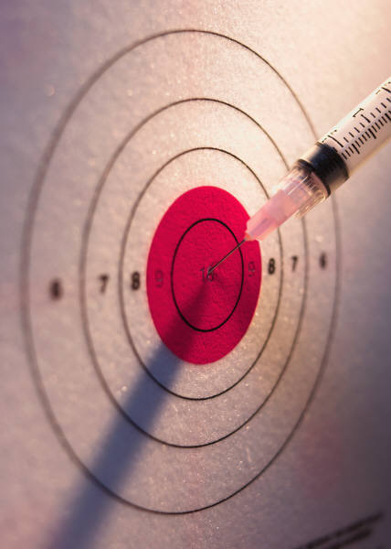
1. Obtain an Accurate Diagnosis
It is vital that before any actions are taken, that we first obtain an accurate diagnosis
Don’t just assume
Communicate
Use appropriate tools
Notes:
With this step, we go back to the basics. We all know it is important to use multiple methods of diagnosing, including biological tests, physical examination, and patient/family interviewing. Inter-professional communication is essential for this step, as a patient may give different details to different members of the healthcare team. This may be one of the easiest steps, as obtaining an accurate diagnosis is something we should be doing anyway!

Slide 11
2. Try the Less Risky Interventions First
Over-the-counter medications
Non-steroidal anti-inflammatory agents
Vitamins and supplements⁸
Non-Medicinal Therapies
Meditation
Acupuncture⁹
Non-controlled prescription medications¹⁰
Notes:
There are many alternatives and supplements to controlled substances for the treatment of anxiety, pain, and ADHD. These alternatives may not be the easy fix that the patient wants, but it may be the safer choice. Many less risky treatments have been proven to be effective. We encourage you to explore your options, do your research, and be able to provide these options to the patient before prescribing a controlled substance.
Omega-3-Fatty Acid Supplements have been studied for the treatment of anxiety – one study showed a 20% decrease in anxiety. A very recent study of the effects of acupuncture on chronic pain showed a 50% or greater reduction in pain in 50% of the participants. Atomoxetine, a non-stimulant treatment for ADHD, was shown to have no significant difference in efficacy as compared to immediate release methylphenidate in a review of 9 randomized trials.
Kiecolt-Glaser JK, Belury MA, Andridge R, et al.. Omega‑3 supplementation lowers inflammation and anxiety in medical students: a randomized controlled trial.. Brain, Behavior, and Immunity.. 2011
http://www.ncbi.nlm.nih.gov/pubmed/21784145
Vickers AJ, Cronin AM, Maschino AC, et al. Acupuncture for chronic pain: individual patient data meta-analysis. Archives of Internal Medicine. September 10, 2012
http://archinte.jamanetwork.com/article.aspx?articleid=1357513
http://www.biomedcentral.com/1471-244X/11/176

Slide 12
3. Get Informed Consent
It is our job to make sure our patients are aware of their treatment¹¹
Benefits
Risks
Concerns
Use a Controlled Substance Agreement
Notes:
*Presenter must be delicate with this information*
When a patient is prescribed a controlled substance, it is our responsibility to educate the patient on the medication. What should the patient expect to get out of this medication? How soon should it start working? What are the potential risks of taking this medication? When it comes to controlled substances, we must discuss with the patient the potential for abuse and addiction. Patient education is the responsibility of every healthcare professional involved and should occur whether the medication is controlled or not.
Having the patient sign a controlled substance agreement is a great way to ensure the patient is well informed and actually understands the information we are providing. Many agreements state a patient cannot seek controlled substances from other sources, will take the medication as prescribed, and will not share medications with friends or family. It can also include the right of the provider to ask the patient to take a urine drug test, goals for treatment, and a limit on refills. This type of agreement holds both the patient and provider accountable.
http://www.painedu.org/articles_timely.asp?ArticleNumber=19
http://www.painphysicianjournal.com/2012/july/2012;15;ES67-ES92.pdf

Slide 13
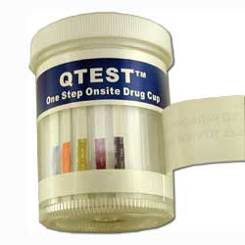
Something to think about
If you wouldn’t prescribe warfarin without checking an INR first, then why would you prescribe controlled substances without doing a urine drug screen?
Notes:
Urine drug screens should be used just like any other medical test. Warfarin requires an INR, diabetes medications require blood glucose checks, why should controlled substances not require a urine drug screen?

Slide 14
4. Urine Drug Screens
Urine drug screens are very seldom wrong, although there are some instances where a false positive can occur
Used for the BENEFIT of the patient and physician
Urine drug screens provide a moment to educate the patient of the risks of substance abuse
Notes:
The use of urine drug screens typically has negative connotations. When most healthcare providers hear “urine drug screen”, they become suspicious of the patient and the reasons they need a screening. When most patients hear “urine drug screen”, they become defensive and hurt that the provider does not trust him/her. This can be avoided by letting your patients know this screening tool is used with each and every patient.
Like any other tool we use, we need to be sure we know how to use it properly. These screens are often conducted by a nurse before the patient is seen by a physician. When using a urine drug screen, be sure you understand how to read and interpret the results. False positives are rare, but they can occur.

Slide 15
5. Assessing Risk Factors for Drug Abuse
Notes:
There are a few simple risk factors for drug abuse that we, as healthcare providers, can screen for. During the screening process, we need to remember that if a patient has a risk factor, it does not mean that patient will abuse a controlled substance. It only means that we must be cautious in our prescribing habits and ensure that the patient is well informed and monitored.

Slide 16
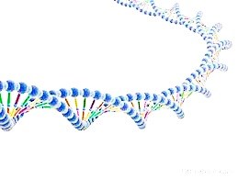
Family History/Genetics
Family history of drug abuse can be a predictor of addiction
Genes account for about 50% of a person’s risk for becoming addicted¹²
It is simple to add a question about familial substance abuse to an already established patient history
Notes:
Like any other disease, addiction can be inherited. Looking at a patient’s family history is an easy first step to predicting that patient’s risk for addiction. Environment also plays a role on the effect of these genes – a patient may have the “addiction genes” but be at a lower risk level due to a positive environment.
http://report.nih.gov/NIHfactsheets/ViewFactSheet.aspx?csid=38

Slide 17
Patient History
Comorbidities
Past behavior has been correlated to increase likelihood of substance misuse
One study examined predictors of opioid misuse¹³
Past cocaine use – 68%
Previous drug or DUI conviction – 40%
Past alcohol abuse – 44%
43.6% of risky users are also addicted to nicotine, alcohol, or an illicit substance¹⁴
Notes:
According to the National Institute on Drug Abuse, 6 out of 10 people with substance abuse disorders also have another mental illness, such as mood disorders or anxiety disorders. This doesn’t mean one disorder caused another, but that each should be treated appropriately to improve patient outcomes. Another predictor of prescription drug abuse is a history of substance abuse. A research article published by BMC Health Services Research studied the predictors of opioid misuse. The researchers determined that opioid misusers were more likely to have a history of substance abuse, such as cocaine or alcohol use. Current addiction is one of the biggest red flags for prescription drug abuse. Research has actually shown that nicotine and opioids have the same relative risk for addiction. Regardless of whether a patient has this history or not, we should still treat the patient appropriately and with caution.
http://www.biomedcentral.com/1472-6963/6/46
http://www.drugabuse.gov/publications/topics-in-brief/comorbid-drug-abuse-mental-illness

Slide 18
Screening Tools
Ask patients about drug abuse
One or four-question quick screen
Alcohol, tobacco, prescription drugs, illicits
Follow-up positive quick-screen with in-depth screening
DAST-10
NIDA-ASSIST
Check the Prescription Monitoring Program
Notes:
The presence of a current addiction is one of the biggest red flags a patient can have. There are multiple screening tools available to determine if patients have this risk. It is important to explain to patients that these questions are asked to every patient you see. We realize that patients may not always answer these questions honestly, but we can use these screens to build patient relationships. If we successfully screen one patient and prevent an addiction from forming, then the screening process is worth it.
The one question drugs screen
Ask, “How many times in the past year have you used an illegal drug or used a prescription medication for nonmedical reasons?”
A response of at least once is considered a positive result and should be followed by a longer assessment of risk.
In a study published in the Archive of Internal Medicine found that the one question screen was 100% sensitive and 73.5% specific for detection of drug disorder. (Peter C. Smith, MD, MSc; Susan M. Schmidt, BA, et al. “A Single-Question Screening Test for Drug Use in Primary Care.” Archive of internal Medicine. 2010;170(13):1155-1160.)
Four-question quick screen
Asks about the frequency of use of 4 substances (Alcohol, Tobacco, Prescription Drugs—non-medical, and illegal drugs)
A response of yes to prescription or illegal drug abuse requires a follow-up screening.
Gives the clinician an opportunity to assess more addictions, which indicate a general risk of addiction.
Follow up screenings
DAST-10: Ten yes/no questions
NIDA-Modified ASSIST: 8 questions that assess frequency of use of various drugs of abuse.
Both follow-ups produce a numeric score that allows clinician to assess relative level of risk.

Slide 19
Prescription Drug Monitoring Program
Collect, monitor, and analyze electronically transmitted prescribing and dispensing data submitted by pharmacies and dispensing practitioners¹⁵
http://www.pmpalliance.org/
Notes:
The prescription drug monitoring program is available or is in the process of being created in 48 states. In Tennessee, it is updated bi-weekly, and can be accessed by a pharmacist, doctor’s office, law enforcement, or patient who is registered with the program. It is a valuable tool that can be used by every profession to monitor patient drug use. The program should be checked for any patient who receives a controlled substance. You can access this website for more information about Tennessee’s program, as well as every other state’s information.

Slide 20
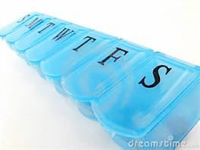
Lack of Knowledge
Be sure the patient is well-informed
What is addiction?
What are the benefits and risks of taking a controlled substance?
How should I store and dispose of medication?
Notes:
Educating patients is one of the most important steps healthcare providers can take when prescribing a controlled substance. If we properly inform patients on the benefits and risks of a controlled substance, they will have a better understanding of the medication they are about to take. It is also important to take this time to inform patients of the possibility and dangers of withdrawal if a controlled substance is stopped abruptly in a dependent or addicted person. Medication storage and disposal is a point that is often over-looked. We have seen that 54% of people who use prescriptions non-medically got those medications from a friend or relative. If that friend or relative knew how to properly store medications – out of sight, in a safe place – or if he knew the legal repercussions of sharing prescription medications, then the medication may have never been abused. Are our patients aware of prescription drug take-back events? Patient education can occur at every step of a patient’s care, in every situation – doctor’s offices, hospitals, pharmacies, the patient’s home – and by every member of the healthcare team.

Slide 21
6. Assess Functioning
Where did they start? Where do they want to go?
Overall physical well-being
Overall mental well-being
Frequency and intensity of symptoms
Notes:
The goal of any treatment is to improve the patient’s quality or quantity of life. Therapy will do that. Before we’ll know if our controlled substance prescriptions are therapeutic, we need to know what the patient’s quality of life was like pre-treatment! Survey the patient. Ask them how bad their symptoms are, get a feel for how much their symptoms interfere with their daily lives. Then, document all of that so you can refer back to it later. This assessment will be your baseline: patients receiving pharmacological treatment see an improvement to their quality of life. Patients feeding an addiction see their quality of life decrease!

Slide 22
7. Time Limited Trial
Determine if patient is to:
Continue therapy
Modify therapy
Discontinue therapy
How do we do this?
Evaluate patient functioning
Use collaborative support from family
Use other reliable third parties
Notes:
When the patient first begins use of a controlled substance, the patient should be reassessed after a short trial. Reevaluate the patient’s functioning – remember, functioning will increase with appropriate treatment and will decrease if the patient is addicted. Talk to the patient’s family to be sure your assessment of functioning is correct. And then determine if the therapy should be continued, modified, or discontinued. This trial allows you the opportunity to catch any early signs of misuse or addiction. This type of trial is used for many other medications. For example, when a person is first placed on a thyroid medication, they must get regular blood work and check ups until the dose is appropriate. If we can do this for non-controlled medications, we can take the time to do the same for controlled substances.

Slide 23
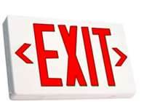
8. Exit Strategy
What do you do if your patient does start to show signs of abuse or addiction?
Have a plan!
Tapering dose¹⁶
Alternative medications
Notes:
If you’re like me, you think it is best to prepare for the worst outcome, and hope for the best. Having the knowledge to help your patient if he or she becomes addicted is the best way to protect your patient.
How do you taper a dose?
Be sure to dose at regular intervals, on a schedule (not prn), and using as much structure as possible.
The speed of tapering varies, depending on the reason and the patient, from 10% total daily dose every day to 10% total daily dose every 1 to 2 weeks.
Alternative medications can be used to replace opioids: methadone, buprenophine, antidepressants, buspirone, anticonvulsants. These may help the patient wean off of the opioid with less side effects.
www.intnsa.org/%2FEvents%2Fdocuments%2F/Sat1125CunninghamJulieOpioidDiscontinuation.pdf
http://nationalpaincentre.mcmaster.ca/opioid/cgop_b_app_b12.html

Slide 24
8. Exit Strategy
Know when and where to refer patients:
SAMHSA Treatment Referral Helpline
1-800-662-HELP
SAMHSA Behavioral Health Treatment Services Locator
Local support groups
Notes:
As healthcare providers, we like to know what we are doing. However, we have to remember that sometimes it is ok to admit that you can no longer help a person. When a patient is exhibiting signs and symptoms of drug abuse, and you don’t know what treatment plan is best, referring the patient to a treatment center may be your best option. The Substance Abuse and Mental Health Services Administration has multiple resources available to help refer patients to treatment centers. Get to know the treatment centers in your area, so if the time comes to refer someone, you are prepared.

Slide 25
9. Periodic Reassessment
Determine whether to continue medication:
There must be actual functional benefit
Benefit must outweigh potential risks
Patients are dynamic – the lack of abuse potential at a previous assessment does not mean a patient will pass screening for abuse potential this time
Notes:
Patient reassessment is used in every disease state. Reassessment is required to determine if the patient is functioning correctly, if the treatment is working effectively, and if anything needs to be modified. It is important to screen at every visit, even after the patient has been on a medication for a while. A patient can screen positive for abuse potential even after several negative screenings.
Massachusetts NIDA Consortium (2009). Prescription Drug Abuse: An Introduction [PowerPoint slides]. Retrieved from DrugAbuse.gov website: http://m.drugabuse.gov/sites/default/files/prescription-drug-abuse-alt.pdf

Slide 26
Tools for Reassessment
COMM
SOAPP
“The COMM™ (Current Opioid Misuse Measure) will help clinicians identify whether a patient, currently on long-term opioid therapy, may be exhibiting aberrant behaviors associated with misuse of opioid medications.”
“SOAPP is intended to predict which patients, being considered for long-term opioid therapy, may exhibit aberrant medications behaviors in the future.” ¹⁷
Notes:
These additional screening tools are valuable predictors of a patient’s medication misuse and should be implemented when a patient is found to have risk factors at reassessment. Patient and family interviews, pill counts, and urine drug screens should be used in addition to COMM in the reassessment of a patient. While these screening tools may be time consuming and may not always be feasible, they are important tools that should be used for the benefit of the patient.
http://painedu.org/soapp.asp

Slide 27
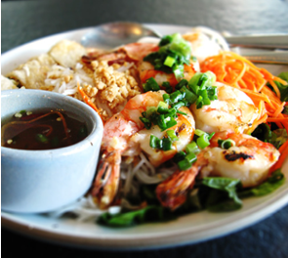
10. Prescribe Conservatively
$1?
$20?
$50... Really?
Notes:
While governmental agencies and volunteer groups are working to remove illegally possessed or abused pharmaceuticals off of the streets, prescribers can help in their own way by limiting the amount of supply going into the market and unlawful hands.
One way to do this is to be conservative in the pill provisions and dosages prescribed. While this may sound like an easy task at first glance, please allow me to illustrate what difficulties can arise with a non-medical scenario we have probably all experienced at least once in our lives. We’re going to use food as an example. Why? Because everyone in this room is physically dependent on it and some people in this world even get addicted to it.
$1 may provide only enough to edge their stomach growling but they will probably still remain hungry.
$20 would be a full meal; but is it so much they would be indulging themselves?
$50 is so much they would have to share?
Providing in excess of what is needed increases the risk of resources being used for unintended/unconstructive purposes but… Not providing enough may not accomplish the desired goal of helping the person in need.

Slide 28
It’s Good To Be Conservative
Being conservative in your prescribing habits serves as a protective barrier against:
1) Second hand distribution
Purposefully – selling or giving away
Accidentally – theft
2) Individual abuse by your patient
Notes:
Limiting the chance of both 1) and/or 2) to occur is the greatest way prescribers can have a hand in reducing the influx of drugs into illegal markets or the hands of drug abusers.
It is important to weigh the risks and benefits when we prescribe any medication, especially when it comes to controlled substances and addiction.

Slide 29
CAUTION: You Can Be Over-Conservative
Remember that $1 bag of chips?
It may not provide enough to address the issue
Being too conservative can lead to complications
Minimal, if any, therapeutic effect of medication
Pain sufferers can exhibit addiction-like symptoms because of low dosing
This iatrogenic syndrome is known as pseudoaddiction¹⁸
Notes:
There is such a thing as prescribing too conservatively. When this happens, a patient can present with a syndrome called pseudoaddiction. This patient will look like an addict searching for more medication, when in reality, the patient is not being treated effectively. While we need to be cautious in prescribing controlled substances, we need to be sure we are correctly treating the patient.
http://www.medicinenet.com/script/main/art.asp?articlekey=53670
http://addictionmanagement.org/Pseudoaddiction%20versus%20Addiction%20in%20a%20Pain%20Population.pdf

Slide 30
Documentation
Provides the best care for patients
Provides protection for
healthcare providers
Enhances communication
Notes:
As we all know, it is important to always secure proper documentation at every visit with a patient. This holds especially true when a controlled substance is being prescribed. Documentation ensures the patient is getting the best care possible. This includes documentation of patient interviews, screening results, diagnosis, and reassessments. Proper documentation allows us to track a patient’s progress and communicate with other healthcare providers.

Slide 31
Communication
Patients
Colleagues
Inter-professional
Notes:
Communication with our patients, our colleagues, and other health-care professionals can greatly improve patient outcomes and prevent prescription drug abuse. Our colleagues can provide insight with their experiences and knowledge. Other healthcare professionals can provide additional information that the patient can or will not provide. This includes the use of the controlled substance monitoring program, which every healthcare provider has access to. Each healthcare field interacts with the patient in a unique way. If we can effectively communicate with one another, we can improve the quality of care our patients receive.

Slide 32
The Fight Against Prescription Drug Abuse
Notes:
Why is it important for you to implement these precautions into your practice? First, it is our job as healthcare providers to provide proper care for our patients. We all took an oath to do no harm, and these precautions are easy ways to prevent our patients from coming to harm. Second, this method has been proven - Project Lazarus, an opioid overdose prevention program in North Carolina, used these precautions along with many other tools for one year. In that year, overdose deaths decreased from 46.6 per 100,000 to 29 per 100,000. If you impact one patient by implementing these precautions, then the effort is worth it. We can make a difference. You can make a difference. I challenge you to do so.

Slide 33
Resources
National Institute on Drug Abuse. Drug facts: prescription and over-the-counter medications. National Institute on Drug Abuse. Updated May 2012. http://www.drugabuse.gov/publications/drugfacts/prescription-over-counter-medications. Accessed October 15, 2012.
Substance Abuse and Mental Health Services Administration. Results from the 2011 National Survey on Drug Use and Health: Summary of National Findings. NSDUH Series H-44. HHS Publication No.(SMA)12-4713. Rockville, MD: Substance Abuse and Mental Health Services Administration, 2012.
The National Center on Addiction and Substance Abuse at Columbia University. Addiction medicine: closing the gap between science and practice. New York: The National Center on Addiction Substance Abuse at Columbia University; June 2012.
National Institute on Drug Abuse. The neurobiology of drug addiction. National Institute on Drug Abuse. Updated January 2007. http://www.drugabuse.gov/publications/teaching-packets/neurobiology-drug-addiction/section-iii-action-heroin-morphine/6-definition-tolerance. Accessed October 20, 2012.
Brunton L, Chabner B, Knollman B, eds. Goodman & Gilman’s The Pharmacological Basis of Therapeutics, 12th Edition. New York: McGraw Hill;2010:652-653.
Drobes, DJ. Concurrent alcohol and tobacco dependence: mechanisms and treatment. National Institute on Alcohol Abuse and Alcoholism. Updated November 2002. http://pubs.niaaa.nih.gov/publications/arh26-2/136-142.htm. Accessed October 28, 2012.
Porth CM, Matfin G. Pathophysiology, Concepts of Altered Health States, Eighth Edition. Philadelphia, Pennsylvania: Lippincott Williams and Wilkins;July 2010:1376.
Kiecolt-Glaser JK, Belury MA, Andridge R, et al. Omega‑3 supplementation lowers inflammation and anxiety in medical students: a randomized controlled trial. Brain, Behavior, and Immunity. 2011;25(8);1725-1734. http://www.ncbi.nlm.nih.gov/pubmed/21784145. Published November 2011. Accessed October 25, 2012.
Vickers AJ, Cronin AM, Maschino AC, et al. Acupuncture for chronic pain: individual patient data meta-analysis. Archives of Internal Medicine. 2012;172(9);1-10. http://archinte.jamanetwork.com/article.aspx?articleid=1357513. Published September 10, 2012. Accessed October 25, 2012.

Slide 34
Resources Continued
Hanwella R, Senanayake M, de Silva V. Comparative efficacy and acceptability of methylphenidate and atomoxetine in treatment of attention deficit hyperactivity disorder in children and adolescents: a meta-analysis. BMC Psychiatry. 2011;11:176. http://www.biomedcentral.com/1471-244X/11/176. Accessed October 25, 2012.
Manchikanti L, Sehgal N, Smith HS. Prescription opioid abuse in chronic pain: a review of opioid abuse predictors and strategies to curb opioid abuse. Pain Physician. 2012;15;67-92. http://www.painphysicianjournal.com/2012/july/2012;15;ES67-ES92.pdf. Published December 2011. Accessed October 17, 2012.
National Institute of Health. Drug abuse and addiction. National Institute of Health: Research Portfolio Online Reporting Tools. Updated February 2011. http://report.nih.gov/NIHfactsheets/ViewFactSheet.aspx?csid=38. Accessed October 16, 2012.
Ives TJ, Chelminski PE, Hammett-Stabler CA, et al. Predictors of opioid misuse in patients with chronic pain: a prospective cohort study. BMC Health Services Research. 2006;6:46. http://www.biomedcentral.com/1472-6963/6/46. Accessed October 10, 2012.
National Institute on Drug Abuse. Topics in brief: comorbid drug abuse and mental illness. National Institute on Drug Abuse. Updated October 2007. http://www.drugabuse.gov/publications/topics-in-brief/comorbid-drug-abuse-mental-illness. Accessed October 25, 2012.
Alliance of States with Prescription Monitoring Programs. Prescription monitoring frequently asked questions. http://www.pmpalliance.org/content/prescription-monitoring-frequently-asked-questions-faq. Accessed November 21, 2012.
Degroote MG. Canadian guideline for safe and effective use of opioids for chronic non-cancer pain: appendix B-12: opioid tapering. McMaster University. April 30, 2010. http://nationalpaincentre.mcmaster.ca/opioid/cgop_b_app_b12.html. Accessed October 12, 2012.
Opioid risk management. September 30,2012. http://painedu.org/soapp.asp. Accessed October 12, 2012.
Quinn TE. Pain topics: what is psuedoaddiction? Pain Relief Connection. 2004;3(1);1. www.mghpcs.org/PCS/Programs/Pain/2004.asp. Accessed October 29, 2012.

